Slide 1
Chapter 3 Probability
3.1. Basic Concepts of Probability
3.2. Three approaches to finding the probability
3.3. Conditional Probability

Slide 2
Key Concept
This section presents three approaches to finding the probability of an event.
The most important objective of this section is to learn how to interpret probability values.

Slide 3
Definitions
Event (Biến cố)
any collection of results or outcomes of a procedure
Simple Event (Biến cố cơ bản)
an outcome or an event that cannot be further broken down into simpler components
Sample Space (Không gian mẫu)
for a procedure consists of all possible simple events; that is, the sample space consists of all outcomes that cannot be broken down any further

Slide 4
Example
In the following display, we use “b” to denote a baby boy and “g” to denote a baby girl.
Procedure | Example of Event | Sample Space
Single birth | 1 girl (simple event) | {b, g}
3 births | 2 boys and 1 girl (bbg, bgb, and gbb are all simple events) | {bbb, bbg, bgb, bgg, gbb, gbg, ggb, ggg}

Slide 5
Notation for
Probabilities
P - denotes a probability.
A, B, and C - denote specific events.
P(A) - denotes the probability of event A occurring.

Slide 6

3.2. Basic Rules for
Computing Probability
Rule 1: Relative Frequency Approximation of Probability (Xác suất theo lối thống kê/Xác suất theo tần suất)
Conduct (or observe) a procedure, and count the number of times event A actually occurs. Based on these actual results, P(A) is approximated as follows:
P(A) =
# of times A occurred
# of times procedure was repeated

Slide 7

Basic Rules for
Computing Probability
Rule 2: Classical Approach to Probability (Xác suất cổ điển)
Assume that a given procedure has n different simple events and that each of those simple events has an equal chance of occurring (Equally likely, đồng khả năng). If event A can occur in s of these n ways, then

Slide 8

Basic Rules for
Computing Probability
Rule 3: Subjective Probabilities
P(A), the probability of event A, is estimated by using knowledge of the relevant circumstances.
Example: When trying to estimate the probability of an astronaut surviving a mission in a space shuttle, experts consider past events along with changes in technologies and conditions to develop an estimate of the probability. As of this writing, that probability has been estimated by NASA scientists as 0.99.

Slide 9
Law of Large Numbers
(Luật số lớn)
As a procedure is repeated again and again, the relative frequency probability of an event tends to approach the actual probability.

Slide 10
Example
When three children are born, the sample space is:
{bbb, bbg, bgb, bgg, gbb, gbg, ggb, ggg}
Assuming that boys and girls are equally likely, find the probability of getting three children of all the same gender.

Slide 11
Simulations
(Mô phỏng)
A simulation of a procedure is a process that behaves in the same ways as the procedure itself so that similar results are produced.

Slide 12
Probability Limits
Always express a probability as a fraction or decimal number between 0 and 1.
The probability of an impossible event (biến cố không thể) is 0.
The probability of an event that is certain to occur (biến cố chắc chắn) is 1.
For any event A, the probability of A is between 0 and 1 inclusive.
That is, .

Slide 13
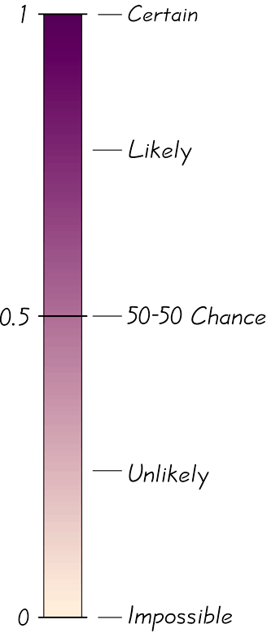
Possible Values for Probabilities

Slide 14
Complementary Events (Biến cố đối)
The complement of event A, denoted by
, consists of all outcomes in which the event A does not occur.

Slide 15
Example
1010 United States adults were surveyed and 202 of them were smokers.
It follows that:

Slide 16
Rounding Off Probabilities
When expressing the value of a probability, either give the exact fraction or decimal or round off final decimal results to three significant digits. (Suggestion: When a probability is not a simple fraction such as 2/3 or 5/9, express it as a decimal so that the number can be better understood.) All digits are significant except for the zeros that are included for proper placement of the decimal point.

Slide 17
Example:
* The probability of 0.04799219 has seven significant digits (4799219), and it can be rounded to three significant digits as 0.0480. (The zero to the immediate right of the decimal point is not significant because it is necessary for correct placement of the decimal point, but the zero at the ex
treme right is significant because it is not necessary for correct placement of the decimal point.)
• The probability of 1/3 can be left as a fraction, or rounded to 0.333. (Do not round to 0.3.)
• The probability of 2/4 can be expressed as or 0.5; because 0.5 is exact, there’s no need to express it with three significant digits as 0.500.
• The fraction 1941/3405 is exact, but its value isn’t obvious, so express it as the decimal 0.570.

Slide 18
Definition
An event is unlikely if its probability is very small, such as 0.05 or less.
An event has an usually low number of outcomes of a particular type or an unusually high number of those outcomes if that number is far from what we typically expect.

Slide 19
Odds (T)
The actual odds against event A occurring are the ratio
, usually expressed in the form of a:b (or “a to b”), where a and b are integers having no common factors.
The actual odds in favor of event A occurring are the ratio , which is the reciprocal of the actual odds against the event. If the odds against A are a:b, then the odds in favor of A are b:a.
The payoff odds against event A occurring are the ratio of the net profit (if you win) to the amount bet.
payoff odds against event A = (net profit) : (amount bet)

Slide 20
Example
If you bet $5 on the number 13 in roulette, your probability of winning is 1/38 and the payoff odds are given by the casino at 35:1.
Find the actual odds against the outcome of 13.
How much net profit would you make if you win by betting on 13?

Slide 21
Example - continued
Find the actual odds against the outcome of 13.
With P(13) = 1/38 and P(not 13) = 37/38, we get:
, or 37:1.

Slide 22
Example - continued
Because the payoff odds against 13 are 35:1, we have:
$35 profit for each $1 bet. For a $5 bet, there is $175 net profit. The winning bettor would collect $175 plus the original $5 bet.

Slide 23
Key Concept
This section presents the addition rule quy tắc cộng) as a device for finding probabilities that can be expressed as P(A or B), the probability that either event A occurs or event B occurs (or they both occur) as the single outcome of the procedure.
The key word in this section is “or.” It is the inclusive or, which means either one or the other or both.

Slide 24
Compound Event (Biến cố hợp)
Compound Event
any event combining 2 or more simple events
Notation
P(A or B) = P(in a single trial, event A occurs or event B occurs or they both occur)

Slide 25
General Rule for a
Compound Event
When finding the probability that event A occurs or event B occurs, find the total number of ways A can occur and the number of ways B can occur, but find that total in such a way that no outcome is counted more than once.

Slide 26
Compound Event
Formal Addition Rule
P(A or B) = P(A) + P(B) – P(A and B)
where P(A and B) denotes the probability that A and B both occur at the same time as an outcome in a trial of a procedure.

Slide 27
Compound Event
Intuitive Addition Rule
To find P(A or B), find the sum of the number of ways event A can occur and the number of ways event B can occur, adding in such a way that every outcome is counted only once. P(A or B) is equal to that sum, divided by the total number of outcomes in the sample space.

Slide 28
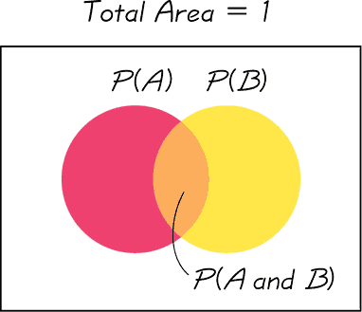
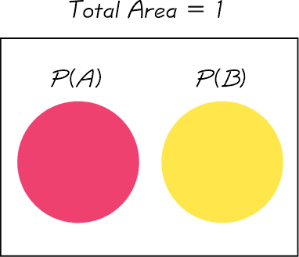
Disjoint or Mutually Exclusive (xung khắc)
Events A and B are disjoint (or mutually exclusive) if they cannot occur at the same time. (That is, disjoint events do not overlap.)
Venn Diagram for Events That Are Not Disjoint
Venn Diagram for Disjoint Events

Slide 29
Complementary Events
A and must be disjoint.
It is impossible for an event and its complement to occur at the same time.

Slide 30
Rule of Complementary Events

Slide 31
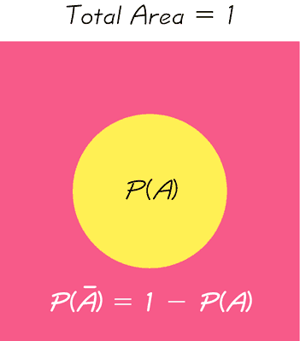
Venn Diagram for the Complement of Event A

Slide 32
3.3. Conditional Probability (XS có điều kiện)
Key Concepts
Probability of “at least one”: Find the probability that among several trials, we get at least one of some specified event.
Conditional probability: Find the probability of an event when we have additional information that some other event has already occurred.

Slide 33
Complements: The Probability of “At Least One”
“At least one” is equivalent to “one or more.”
The complement of getting at least one item of a particular type is that you get no items of that type.

Slide 34
Finding the Probability of “At Least One”
To find the probability of at least one of something, calculate the probability of none and then subtract that result from 1. That is,
P(at least one) = 1 – P(none).

Slide 35
Example
Topford supplies X-Data DVDs in lots of 50, and they have a reported defect rate of 0.5% so the probability of a disk being defective is 0.005. It follows that the probability of a disk being good is 0.995.
What is the probability of getting at least one defective disk in a lot of 50?

Slide 36
Example – continued
What is the probability of getting at least one defective disk in a lot of 50?

Slide 37
Conditional Probability
(Xác suất có điều kiện)
A conditional probability of an event is a probability obtained with the additional information that some other event has already occurred. denotes the conditional probability of event B occurring, given that event A has already occurred, and it can be found by dividing the probability of events A and B both occurring by the probability of event A:

Slide 38
Intuitive Approach to Conditional Probability
The conditional probability of B given A can be found by assuming that event A has occurred and then calculating the probability that event B will occur.

Slide 39
Example
Refer to the table to find the probability that a subject actually uses drugs, given that he or she had a positive test result.
 | Positive Drug Test | Negative Drug Test
Subject Uses Drugs | 44 (True Positive) | 6 (False Negative)
Subject Does Not Use Drugs | 90 (False Positive) | 860 (True Negative)

Slide 40
Example - continued
 | Positive Drug Test | Negative Drug Test
Subject Uses Drugs | 44 (True Positive) | 6 (False Negative)
Subject Does Not Use Drugs | 90 (False Positive) | 860 (True Negative)

Slide 41
Confusion of the Inverse
To incorrectly believe that and are the same, or to incorrectly use one value for the other, is often called confusion of the inverse.

Slide 42
Key Concept
The basic multiplication rule (quy tắc nhân) is used for finding P(A and B), the probability that event A occurs in a first trial and event B occurs in a second trial.
If the outcome of the first event A somehow affects the probability of the second event B, it is important to adjust the probability of B to reflect the occurrence of event A.

Slide 43
Notation
P(A and B) = P(event A occurs in a first trial and event B occurs in a second trial)
P(B | A) represents the probability of event B occurring after event A has already occurred.
Notes:
To differentiate between the addition rule and the multiplication rule, the addition rule will use the word ‘or’ - P(A or B) - , and the multiplication rule will use the word ‘and’ - P(A and B).
Page 159 of Elementary Statistics, 10th Edition

Slide 44
Formal Multiplication Rule

Slide 45
Intuitive Multiplication Rule
When finding the probability that event A occurs in one trial and event B occurs in the next trial, multiply the probability of event A by the probability of event B, but be sure that the probability of event B takes into account the previous occurrence of event A.
Notes:
Many students find that they understand the multiplication rule more intuitively than by using the formal rule and formula.
Example on page 162 of Elementary Statistics, 10th Edition

Slide 46
Caution
When applying the multiplication rule, always consider whether the events are independent or dependent, and adjust the calculations accordingly.

Slide 47
Multiplication Rule for Several Events
In general, the probability of any sequence of independent events is simply the product of their corresponding probabilities.

Slide 48
Dependent and Independent (Biến cố độc lập, không độc lập)
Two events A and B are independent if the occurrence of one does not affect the probability of the occurrence of the other.
(Several events are similarly independent if the occurrence of any does not affect the probabilities of the occurrence of the others.)
If A and B are not independent, they are said to be dependent.
Notes:
Page 162 of Elementary Statistics, 10th Edition

Slide 49
Dependent Events
Two events are dependent if the occurrence of one of them affects the probability of the occurrence of the other, but this does not necessarily mean that one of the events is a cause of the other.
Notes:
Page 162 of Elementary Statistics, 10th Edition

Slide 50
Treating Dependent Events as Independent
Some calculations are cumbersome, but they can be made manageable by using the common practice of treating events as independent when small samples are drawn from large populations. In such cases, it is rare to select the same item twice.
Notes:
Since independent events where the probability is the same for each event is much easier to compute (using exponential notation) than dependent events where each probability fraction will be different, the rule for small samples and large population is often used by pollsters.
Page 163 of Elementary Statistics, 10th Edition

Slide 51
The 5% Guideline for Cumbersome Calculations (trở ngại)
If a sample size is no more than 5% of the size of the population, treat the selections as being independent (even if the selections are made without replacement, so they are technically dependent).
Notes:
Since independent events where the probability is the same for each event is much easier to compute (using exponential notation) than dependent events where each probability fraction will be different, the rule for small samples and large population is often used by pollsters.
Page 163 of Elementary Statistics, 10th Edition

Slide 52
Example
Suppose 50 drug test results are given from people who use drugs:
If 2 of the 50 subjects are randomly selected without replacement, find the probability that the first person tested positive and the second person tested negative.
Positive Test Results: | 44
Negative Test Results: | 6
Total Results: | 50
Notes:
Since independent events where the probability is the same for each event is much easier to compute (using exponential notation) than dependent events where each probability fraction will be different, the rule for small samples and large population is often used by pollsters.
Page 163 of Elementary Statistics, 10th Edition

Slide 53
Example – continued
If 2 of the 50 subjects are randomly selected without replacement, find the probability that the first person tested positive and the second person tested negative.
Positive Test Results: | 44
Negative Test Results: | 6
Total Results: | 50
Notes:
Since independent events where the probability is the same for each event is much easier to compute (using exponential notation) than dependent events where each probability fraction will be different, the rule for small samples and large population is often used by pollsters.
Page 163 of Elementary Statistics, 10th Edition

Slide 54
Example
When two different people are randomly selected from those in your class, find the indicated probability by assuming birthdays occur on the same day of the week with equal frequencies.
Probability that two people are born on the same day of the week.
Probability that two people are both born on Monday.
Notes:
Since independent events where the probability is the same for each event is much easier to compute (using exponential notation) than dependent events where each probability fraction will be different, the rule for small samples and large population is often used by pollsters.
Page 163 of Elementary Statistics, 10th Edition

Slide 55
Example – continued
Probability that two people are born on the same day of the week.
Because no particular day is specified, the first person can be born on any day. The probability that the second person is born on the same day is 1/7, so the probability both are born on the same day is 1/7.
Probability that two people are both born on Monday.
The probability the first person is born on Monday is 1/7, and the same goes for the second person. The
probability they are both born on Monday is: .
Notes:
Since independent events where the probability is the same for each event is much easier to compute (using exponential notation) than dependent events where each probability fraction will be different, the rule for small samples and large population is often used by pollsters.
Page 163 of Elementary Statistics, 10th Edition

Slide 56
Tree Diagrams
A tree diagram is a picture of the possible outcomes of a procedure, shown as line segments emanating from one starting point. These diagrams are sometimes helpful in determining the number of possible outcomes in a sample space, if the number of possibilities is not too large.

Slide 57
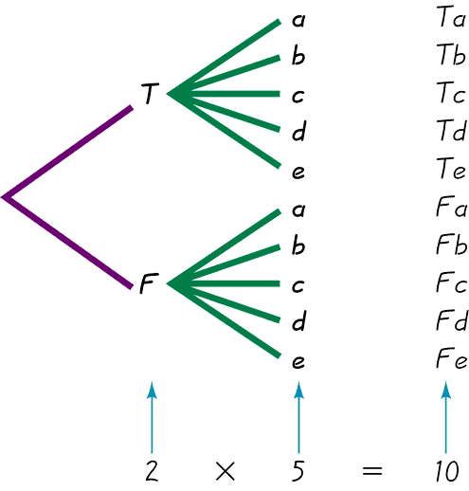
Tree Diagrams
This figure summarizes
the possible outcomes
for a true/false question followed
by a multiple choice question.
Note that there are 10 possible combinations.

Slide 58
Summary of Fundamentals
In the addition rule, the word “or” in P(A or B) suggests addition. Add P(A) and P(B), being careful to add in such a way that every outcome is counted only once.
In the multiplication rule, the word “and” in P(A and B) suggests multiplication. Multiply P(A) and P(B), but be sure that the probability of event B takes into account the previous occurrence of event A.

Slide 59
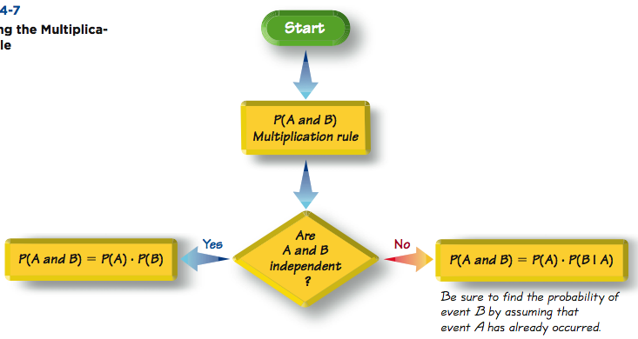
Applying the
Multiplication Rule

